Slide 1
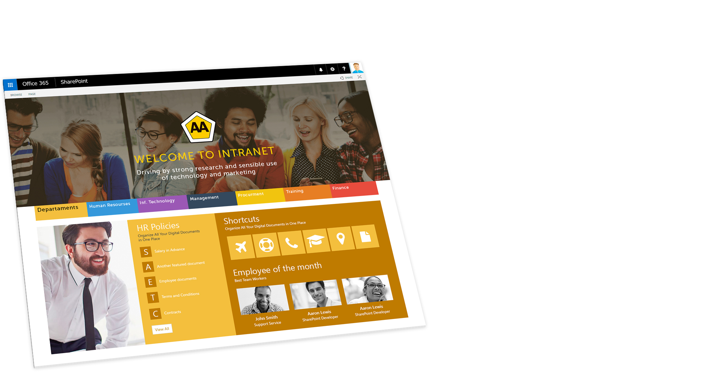
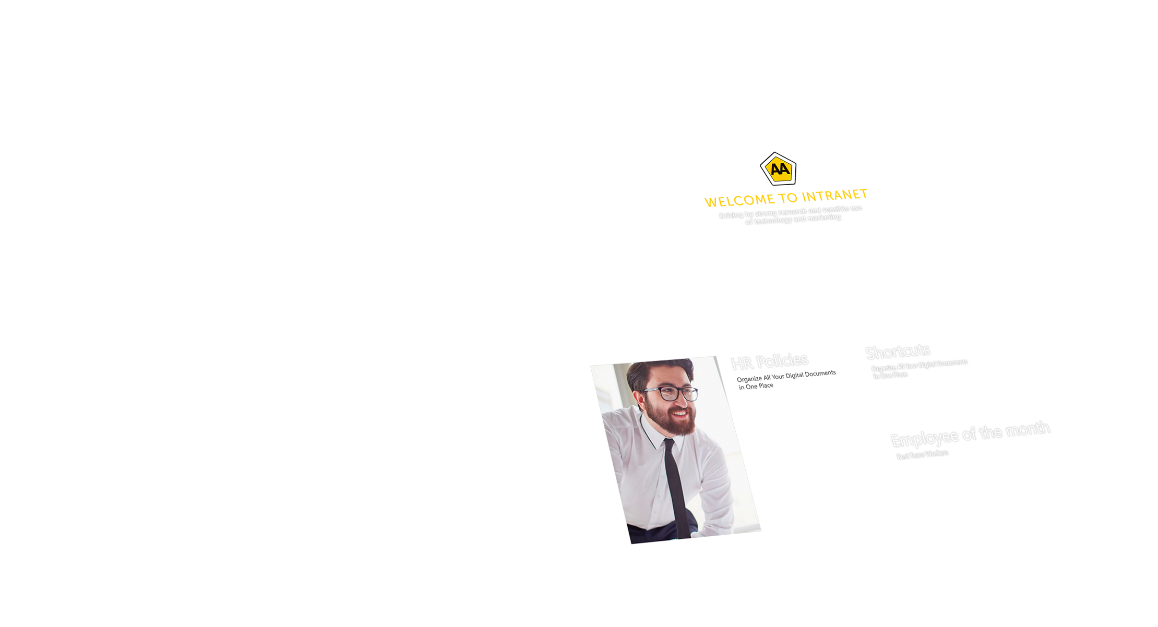
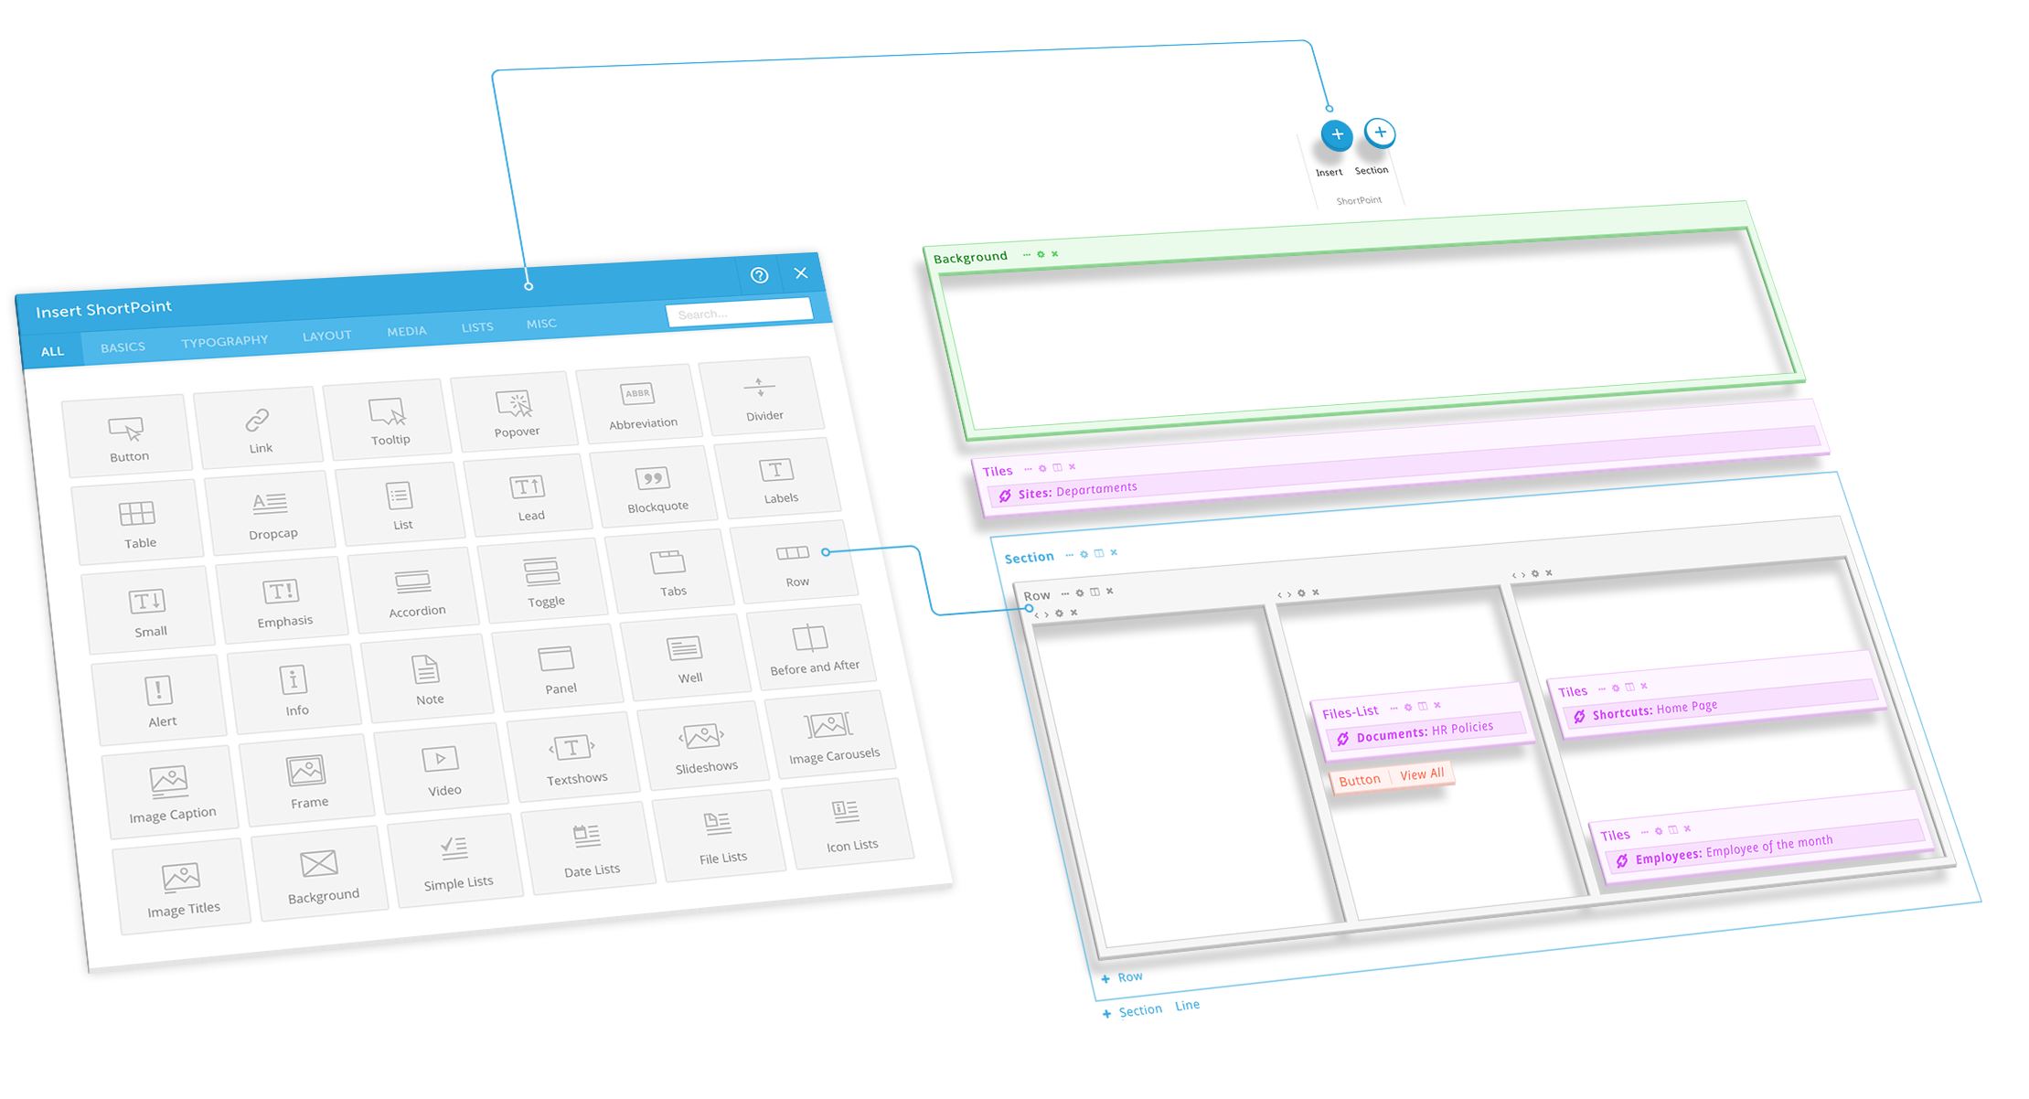
About ShortPoint:
ShortPoint is an innovative software company, specialized in simplifying the digital content creation and management and to boost collaboration, productivity, and adoption. The global experience of ShortPoint platform brings the latest code-behind web browser technology, and enable you to create a world-class user interface and experience that works on any device.

Slide 2
Challenges
SharePoint has a very powerful content authoring features but does not include any web design features.
Months of work and load
Very high development cost
Poor user experience and design
Low quality sites

Slide 3
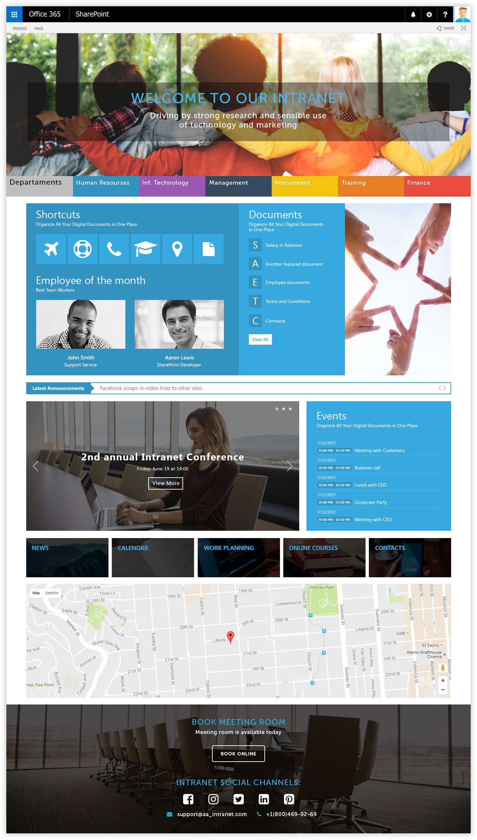
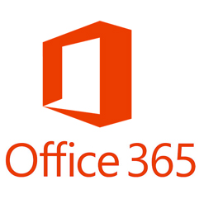
Reseller view: How it works – Option 1
Install
Use ShortPoint Copy/Paste Feature
Publish
On the Client Environment
Build and Design SharePoint using ShortPoint at your environment

Slide 4
Reseller View: How it works – Option 2
Install
Publish
Build and Design SharePoint using ShortPoint at client environment
On the Client Environment

Slide 5
Why ShortPoint
No coding
Brand, Design, & Integrate – Fully mobile responsive
World’s most advance branding platform
Ultra-fast installation, and get results in minutes
100% Customers Satisfaction From Day One
Modern and latest trends results

Slide 6
Why Sell ShortPoint
Scale your business by up-selling and cross-selling (Increase Stickiness )
Extend the usage of the platform to Non-IT departments (HR, Marketing, etc.)
More usage and adoption from other departments, the more requirements and new businesses generated
Save up to 70% your cost

