Slide 1
EVERFLEX STAAS
EverFlex Storage as a Service –
STaaS Subscription
Overview for Partners
<Name> <Title>
Tuesday, October 8, 2024
© Hitachi Vantara LLC 2024. All Rights Reserved.
Notes:
Introduce yourself and begin.

Slide 2
Why Sell Infrastructure as a Service (IaaS)?
All Major Infrastructure Vendors have or are developing offerings in this space. HPE Greenlake, Dell Apex, Pure Evergreen//One
13%
30%
75%
YoY Growth
ECB Storage
RTM Market
as a Service business
in a $1.4B market today
(at approx. 6% today)
IDC 2024
Will be based on acquisition by consumption versus traditional capex by 2028
(at approx. 12% today)
Gartner May 2024
will be indirect Tier-1 and Tier-2
over next 3-5 years
(HV is at approx. 70% today)
Gartner May 2024
Notes:
Before we get into the details of the call, I think it’s important to talk about why we are investing in this space.
It should be no surprise to any of you on this call that all of our major vendors have or are developing offerings in this space. HPE, Dell and Pure to name a few.
And there have been a ton of studies in this space, not just by TSIA, the Technology Services Industry Association – If you are not familiar with them, they only focus on the as a Service market – but certainly by Gartner and IDC as you would expect.
For example, 13%. according to IDC, excluding pure public cloud deployments, the on-premises Infrastructure as a Service business is at about $1.4B, and growing from about 6% YoY in 2021 to about 13% YoY today. Meaning we are seeing an acceleration in market adoption.
30%. Gartner states that the External Controller Based market, i.e. the VSP line of products, while at about 12% today being delivered on consumption versus through capital acquisition, is expected to grow to over 30% within the next 3-4 years.
And 75%. There should be no surprise here, but the partner landscape is changing rapidly. VARs and SI’s as well as Distributors are all building managed services business practices. Gartner predicts that the as a Service RTM will move from primarily direct today to over 75% within the next 3-5 years.
<Click>

Slide 3

EverFlex Infrastructure as a Service | EverFlex IaaS
Cloud Experience
On-premises hybrid cloud infrastructure with enterprise-class reliability
Hitachi EverFlex is Hitachi’s Infrastructure as a Service (IaaS) portfolio with flexible capacity and pay per use elastic consumption, delivered and managed your way, providing customers and partners with adaptable options tailored to their needs.
Whether clients prefer self-managed setups with reporting to fully managed operations from Hitachi or a trusted partner, EverFlex delivers unparalleled flexibility and choice
Flexible Pay-per-Use
Consumption-based infrastructure with zero utilization gap
Self-Managed, Partner Managed
or Hitachi Managed
Pre-integrated architecture with customization as needed
Heterogeneous Orchestration
Provisioning, observability, alerting, automation and self-service
Flexible, Predictable & Cloud Managed
© Hitachi Vantara LLC 2024. All Rights Reserved.
Notes:
At a high level, what is Hitachi EverFlex?
<Click>
Hitachi EverFlex is Hitachi’s Infrastructure as a Service (IaaS) portfolio with flexible capacity and pay per use elastic consumption, delivered and managed your way, providing customers and partners with adaptable options tailored to their needs.
Whether clients prefer self-managed setups with reporting to fully managed operations from Hitachi or a trusted partner, EverFlex delivers unparalleled flexibility and choice.
Now specifically we can break this down into 4 key characteristics:
<Click>
First, EvefFlex delivers a Cloud Experience.
EverFlex provides on-premises cloud infrastructure with enterprise-class reliability. Namely storage, compute and network-based solutions with a cloud-management experience using our EverFlex Control management framework and Hitachi Services Manager quote-2-cash SaaS console.
<Click>
Second is pay-per-use
EverFlex is only offered as a consumption service and includes the ability for partners and customers to be charged for what they use, including and above a minimum commit. Our consumption model ranges from simple opex leasing through to full as-a-Service subscription, and managed services.
<Click>
Third, EverFlex offers a choice of management options – self-managed, partner-managed or Hitachi-managed.
Partners and customers can simply access infrastructure resources, owned by Hitachi, but managed by themselves to reduce financial burden of upfront capital purchases; or they can choose from a variety of pre-architected subscription offerings enabling fast-time-to-market, through to fully customizable and flexibble solutions to meet any business need.
<Click>
And forth, heterogenous orchestration with EverFlex Control
This includes provisioning and observability at the resource usage level, through to intelligent alert management, task automation, and self-serve access for full control over operational needs.
<Click>

Slide 4





EverFlex | IaaS Portfolio
EverFlex is a portfolio of as-a-service and consumption-based offers for workload transformation and hybrid cloud operations
Integrated Partner Solutions
Hitachi and Partner Services
Control
Cisco
Red Hat
VMware
Diamanti
Commvault
Ansible
Industry Solutions
Blueprinting & Co-creation
Consulting & Operations
Console
Orchestration
Provisioning
Observability
Alerting and Self-Healing
Identity & Access Management
Open API
Quote-to-Billing Lifecycle
Self Service
SLA Management
Service Catalog
Storage (STaaS) (Block, File, Object)
Converged Infrastructure (CIaaS)
Data Protection (DPaaS)
Containers (CaaS)
Virtual Machine (VMaaS)
SAN Networking (SNaaS)
Bare Metal (BMaaS)
Backup (BaaS) / DR (DRaaS)
Ransomware Protection (RPaaS)
FinOps
Notes:
In short,
EverFlex is a portfolio of as-a-service and consumption-based offers for workload transformation and hybrid cloud operations
It consists primarily of four elements:
<Click>
EverFlex Control. Think of this as a management framework that provides a range of capabilities including orchestration, provisioning, alerting, IAM and an Open API library.
Upcoming it will leverage quote-2-cash lifecycle integration with Hitachi Services manager or HSM – HSM today is used for our current and future subscription offerings.
<Click>
Integrated partner solutions include those with Cisco, Red Hat, Vmware, Commvault and more, and includes our recent HC2 offering.
<Click>
Hitachi and Partner Services. No Infrastructure offering is complete without a full contingent of professional and consulting services.
<Click>
And the Service catalog that includes services ranging from STaaS, Converged and Data Protection as subscription offerings to more customized offerings including container through to FinOps services.
<Click>

Slide 5





EverFlex | IaaS Subscription Portfolio
Subscription-based offerings with self-serve access portal that provides quote to cash workflow and delivers access to a cloud-managed infrastructure from Hitachi Vantara.
STaaS Subscription
CIaaS
DPaaS
Block Storage
Consumption Pricing
Backup & Recovery
Based on VSPE supporting multiple uses cases with SLAs for performance tiers and capacity bands
Hybrid (ultra & value)
Ultra
Value
Performance
Standard
Predefined architecture to support growth, drive competitive advantage with ready-to use, reliable network, storage & compute.
Small
Medium
Flex
Quick recovery from data loss, corruption and system failures based on Metallic from Commvault.
→ Check with your Hitachi Partner Manager for release availability.
Object Storage
as a Service Subscription
Based on HCPCS supporting vault uses cases with SLAs for performance tiers and capacity bands
Integrated with Storage as a Service and keeping the essence of first release. → Upcoming FY25
Notes:
Within the EverFlex IaaS Portfolio, this slide highlights Hitachi’s subscription offerings. These offerings are all predefined architectures, with predefined capacity and performance metrics. They are ready to be operational within a matter of hours once rolled on to the datacenter floor, networked, and powered on.
Our first offering is our Storage as a Service Offering. We provide an Uptime, Performance, and Console Availability SLA within this offering. The STaaS Offering has 5 Block Storage tiers and 1 Object Storage tier that support everything from AI/ML workloads to infrequent accessed backup target.
Our next offering being released in at the end of September is Converged Infrastructure as a Service. This will come in 3 options, Small, Medium, and Flex, and will be consumption based in the September release. As we continue to build the offering, expect the SLA’s for CIaaS in Q1 of FY25.
Lastly, we will be releasing a Data Protection as a Service offering focused initially on Backup & Recovery. This offiering is heavily integrated with CommVault Metallic and you can expect to capture both local, cloud, and hybrid datasources for backup in this offering. We expect to see this toward the end of Q3 this fiscal year.

Slide 6





EverFlex | Storage as a Service (STaaS) Subscription
A pay as you grow storage service providing the ability to request, provision and manage storage – deployed at a Partner, colocation data center or end-customer facility.
Challenge
Long wait between ordering and finalizing implementation
Heavy upfront costs and hide extra costs
Complex decision and endless options
Provider's cloud storage commitment fear
Multiple tools to manage multiple solutions
Predefined
Architecture
Subscription
Based Billing
Tiers & Bands
CSP & Resell Models
EverFlex
Control
Shipped pre-configured to reduce deployment time
Operates on an OPEX basis and rate card is provided upfront for accelerated quoting
Tiers for Performance Bands for Capacity
As low as 50TB 1 to 5 years
Allowing partners to choose their level of management involvement
One console to manage quote to cash and provisioning
Hitachi Services Manager
Solution
Notes:
So quickly, I want to I want to highlight what your partner and subscribers get with our Infrastructure Offerings by highlighting what we have done with the Storage as a Service Offering.
<Click>
First, everything is predefined in the portfolio. This enables us to help minimize the sales engineering timeline and the long waits between ordering and implementation.
<Click>
Secondly, customers don’t have to pay for everything upfront, they can buy what they need now based on our catalog of options.
<Click>
Speaking of options, everything we have is broken into tiers and bands, this way customers have different performance and capacity profiles and can align their needs to the predefined architectures.
<Click>
Fourth, we provide this in a Partner aligned model and give CSP’s & Resellers the ability to choose how integrated they want to be with Day 2 operations. We can handle it for them, or they can choose to support Day 2 ops.
<Click>
Lastly, with Everflex Control, we use one console to manage, Q2C, and provision subscribed resources.
<Click>

Slide 7

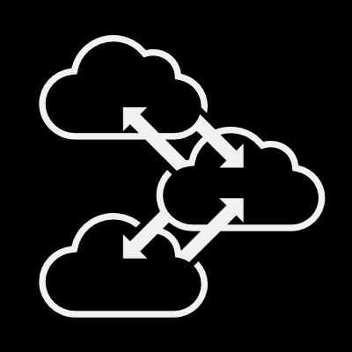






STaaS Subscription | Service Attributes
MANAGEMENT
STORAGE CAPACITY
BILLING FLEXIBILITY
One unique self-service console to manage all your Hybrid Cloud Storage
Start as low as 50TBs and range into multiple petabytes.
Minimum Monthly Payment + flexible value to cover excess in that MMP
Value Tier
Standard Tier
Performance Tier
Ultra Tier
Hybrid Tier
Object Tier
Hitachi Services Manager
50TB
(Minimum)
Flexible
Committed
CONTRACT TERM
SERVICE LEVELS
DEPLOYMENT
Ranging from 1 to 5 years with pricing per GB diminishing as the contract term and capacity tier increases.
Based on service up time and systems-level performance.
Same Day service activation deployed on premise or colocation facility
100%
1
5
Data Storage
Availability
Fully
Configured
Storage*
Only
On-Prem
or Colo
Notes:
And here are the core attributes to the STaaS offering
<Click>
First, Management of the service is achieved through the STaaS Cloud Management Console, running in public cloud to provide maximum global access and agility.
<Click>
STaaS storage capacities start as low as 50TBs and range into multiple petabytes and include multiple capacity tiers such as Value, Standard, Performance, Ultra, Hybrid and Object.
<Click>
Monthly billing consisting of a committed value that forms the base Minimum Monthly Payment (or MMP) and a flex fee that covers excess usage costs above that of the MMP.
<Click>
Contract terms range from 1 to 5 years with pricing per GB diminishing as the contract term and capacity tiers increase.
<Click>
Service Levels are based on service up time and systems-level performance. Data Storage availability is at 100%.
<Click>
And STaaS deployment with same day service activation, as well as a choice of a fully-configured pre-integrated racked option OR a storage-only option. Both configurations can be deployed on premises or at a preferred colocation facility from the Hitachi Vantara partner ecosystem.
<Click>

Slide 8
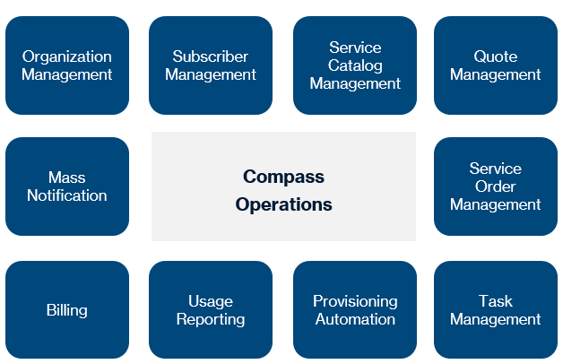
STaaS Subscription | Hitachi Services Manager
This console is a turn-key Quote-to-Cash workflow and governance system that enables the automation of the entire order management process
Org/User Administration
Public/Private Product Catalog
Solution Quoting
Service Order Management
Usage and Billing
Subscriber and Resellers Communications
Integrates with existing CRM applications
Supports the complete subscriber life-cycle including self-service
Integrates with practically any existing, in-place infrastructure
Hitachi Services
Manager
Notes:
Hitachi Services Manager is
a turn-key Quote-to-Cash workflow and governance system that enables the automation of the entire order management process
<Click>
First Hitachi Services Manager is module-based. Depending on the ‘Persona’ you have – Hitachi, Distribution, CSP Partner or Subscriber, will determine which modules you have access to.
The modules range from the management of organizations, subscribers service catalogues, quotes, service orders and tasks, supported by a number of utility services for provisioning, reporting and billing.
<Click>
Hitachi Services Manager, is about business automation with key attributes such as single and multi-tenancy, multi-lingual and multi-currency support, partner branding, and full API-enablement for most all functions.
<Click>

Slide 9
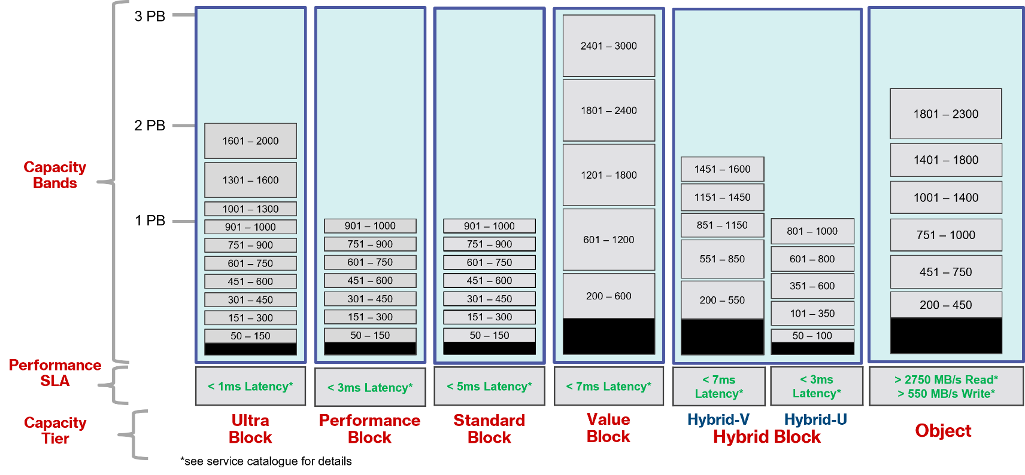
STaaS Subscription | Service Catalog
Minimum Commit (MCV)
Low Water Mark
High Water Mark
Notes:
This slide outlines each of the storage tiers as well the details of each of the tier capacity bands.
<Click>
As mentioned, there are 6 capacity tiers
<Click>
Each with a specific performance SLA
<Click>
As you can see, each tier is broken into several capacity bands. Each band represents a low-water and high-water mark in capacity.
For example, for the Value Block tier, there are 5 capacity bands: 200-600, 601-1200, 1201-1800, 1801-2400 and 2401 to 3000 TB.
<Click>
If we look at the second band, 601-1200, the low-water mark is 601 and the high-water mark is 1200. It is the low-water mark of 601TB that represents the minimum commit value for billing. In addition, the delta between 601 and 1200TB represents the flexible consumption area where billing is based only on what is used. As a result, total billing is calculated based on the low-water mark, minimum commit, plus whatever usage occurs during the month within the flexible consumption area.
<Click>

Slide 10
STaaS Subscription | Billing Model
Total Capacity deployed
High-water mark
1200TB
Subscriber can Flex up and down at any point within this area
Flex
Capacity
100%
Low-Water Mark
Value
Tier
Band B
Band B
Capacity Band
601TB
Band A
MMP is Billed when actual consumption is less than MMP
Minimum Commit
Capacity (MMP)
0%
Term (Single Capacity Tier)
LEGEND
Capacity Band Low-water Mark
Total Capacity Deployed
Total billing = MMP + Flex
Service Order required for each initial tier
Change Order required for each new band
Signatures and PO required for each
Capacity Band High-water Mark
Total Customer Usage
Minimum Commit Capacity (MMP)
Flex Capacity (Flex)
Notes:
Let’s look at the billing model in a bit more detail
<Click>
Carrying on from the previous slide, we will use the second band, band B, of the Value Tier. 601TB to 1200TB.
<Click>
Billing is based on a combination of the Term for a single capacity tier, and the capacity band currently under contract.
<Click>
In this example, the low-water mark, list in dotted line yellow, is 601 for Band B.
<Click>
The high-water mark is shown at the top in dotted line blue.
<Click>
The black line at the very top represents the total capacity deployed, which is typically 15% greater then the defined high-water mark for the capacity band.
<Click>
You will see within the low-water mark area, highlighted in grey, is the minimum commit area, or the Minimum Monthly Payment (MMP).
<Click>
The Blue area between the low-water and high-water marks are considered the Flexible consumption area.
<Click>
The purple solid line in the middle, provides and example of typical customer usage, representing the minimum commit up to the low-water mark, and the flexible usage, which fluctuates, within the blue area.
<Click>
You can see from the red arrow, that the MMP is always billed, regardless if usage falls below the low-water mark.
<Click>
The Subscriber can Flex up and down at any point within the flexible consumption area, resulting in a billing model of the MMP (minimum monthly payment) plus the average usage of storage within the flexible consumption area.
<Click>
In summary, the total monthly bill is equal to sum of the minimum monthly payment plus the average flex usage above minimum commit.
Service orders are required for the initial deployment and change orders are required for the upgrade to additional storage bands.
Signatures and Purchase Orders are required for each.
<Click>

Slide 11
STaaS Subscription | Managed Your Way
Shared Management Model
Hitachi Responsibility
Distribution Responsibility
Partner Responsibility
Hitachi Services Manager
Partner Engagement
Subscriber Engagement
Service Deployment and Activation
Partner Onboarding*
Service Operations (IaaS)
HW and SW (STaaS On-Premise POD)
Rate Card and Contract Mgmt
Network Connectivity (last mile)
Level 0/1 on Deals to Distribution
Level 0/1 on Service to Partner
Level 0/1 Support on Deals to Partner
Level 0/1 Service Support
Onboarding support by Hitachi for Distribution Partners
Onboarding support by Hitachi for Resell Partner Subscribers
In addition, activities supported by Hitachi Vantara in a RESELL model
Notes:
The STaaS Subscription service offering is built upon a shared management model.
<Click>
That includes Shared-risk and shared-reward between Hitachi Vantara, Distribution and the Partner.
Each has responsibilities for the delivery of the service
<Click>
Hitachi is responsible for the Hitachi Service Management application as a SaaS platform.
Hitachi is responsible for the infrastructure ownership, deployment and service activation at the end-customer, co-location or partner data center.
<Click>
Distribution is responsible for downstream partner engagement, onboarding, rate card and contract management, as well as level 0/1 on transactions with the partner.
<Click>
And the Partner is responsible for Subscriber Engagement as a foundational responsibility.
If the partner is a Manage Partner, the responsibility for service operations, last mile network connectivity and interfacing with the Subscriber on support matters lies with them.
If however, the Partner is a Resell Partner, then service operations and direct support of the customer is Hitachi’s responsibility. The partner is still responsible for engaging with the Subscriber both during service setup as well as ongoing after the service is operational.
<Click>
<Click>
In addition, Hitachi Vantara will support our Distribution Partners for engagements with our CSP Partners, as needed to ensure successful deployments and service delivery
<Click>

Slide 12
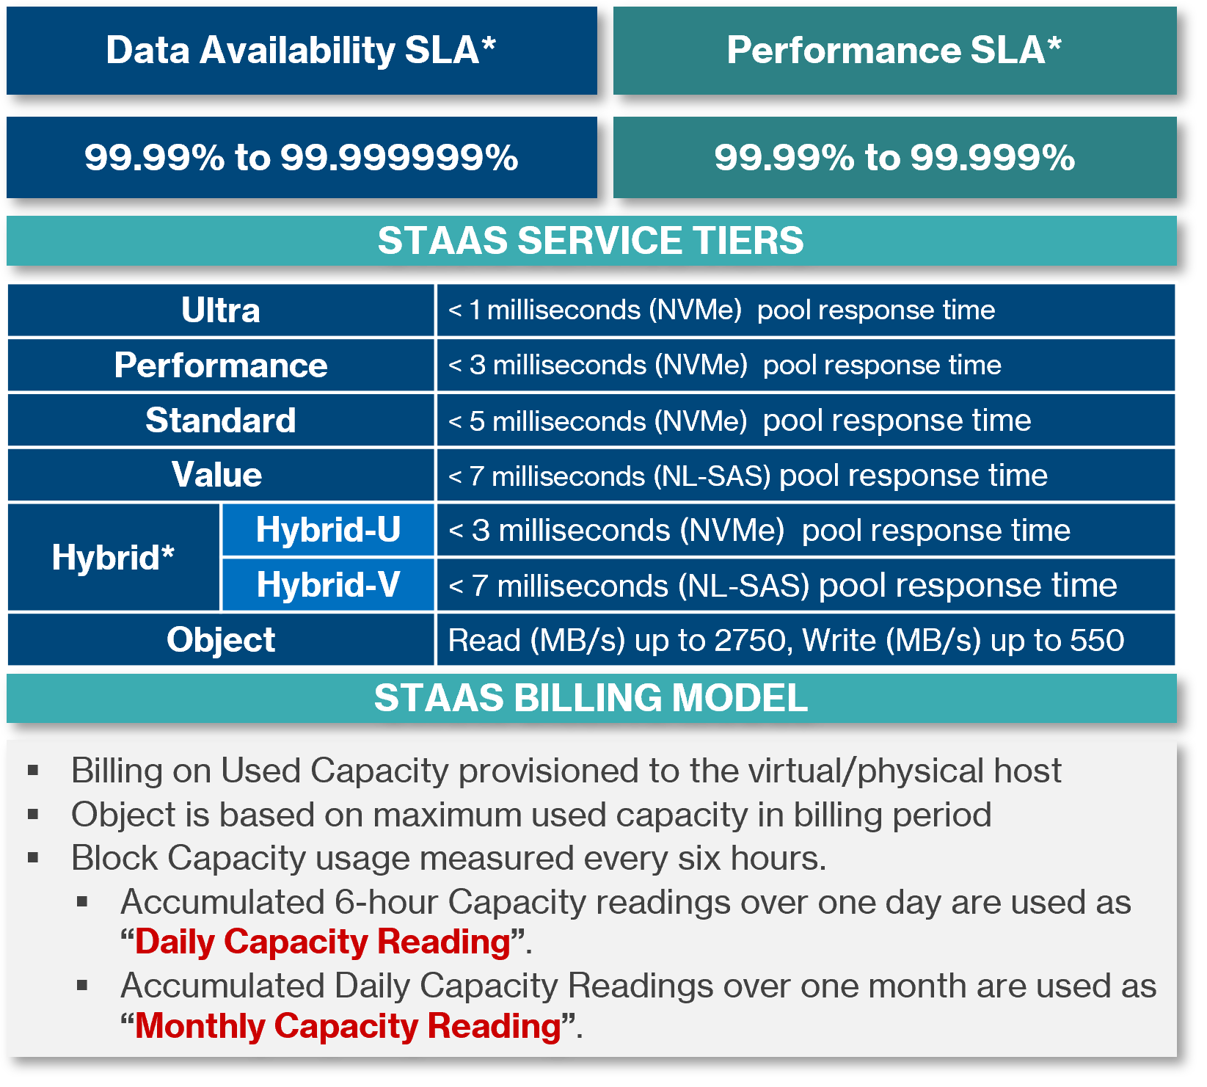
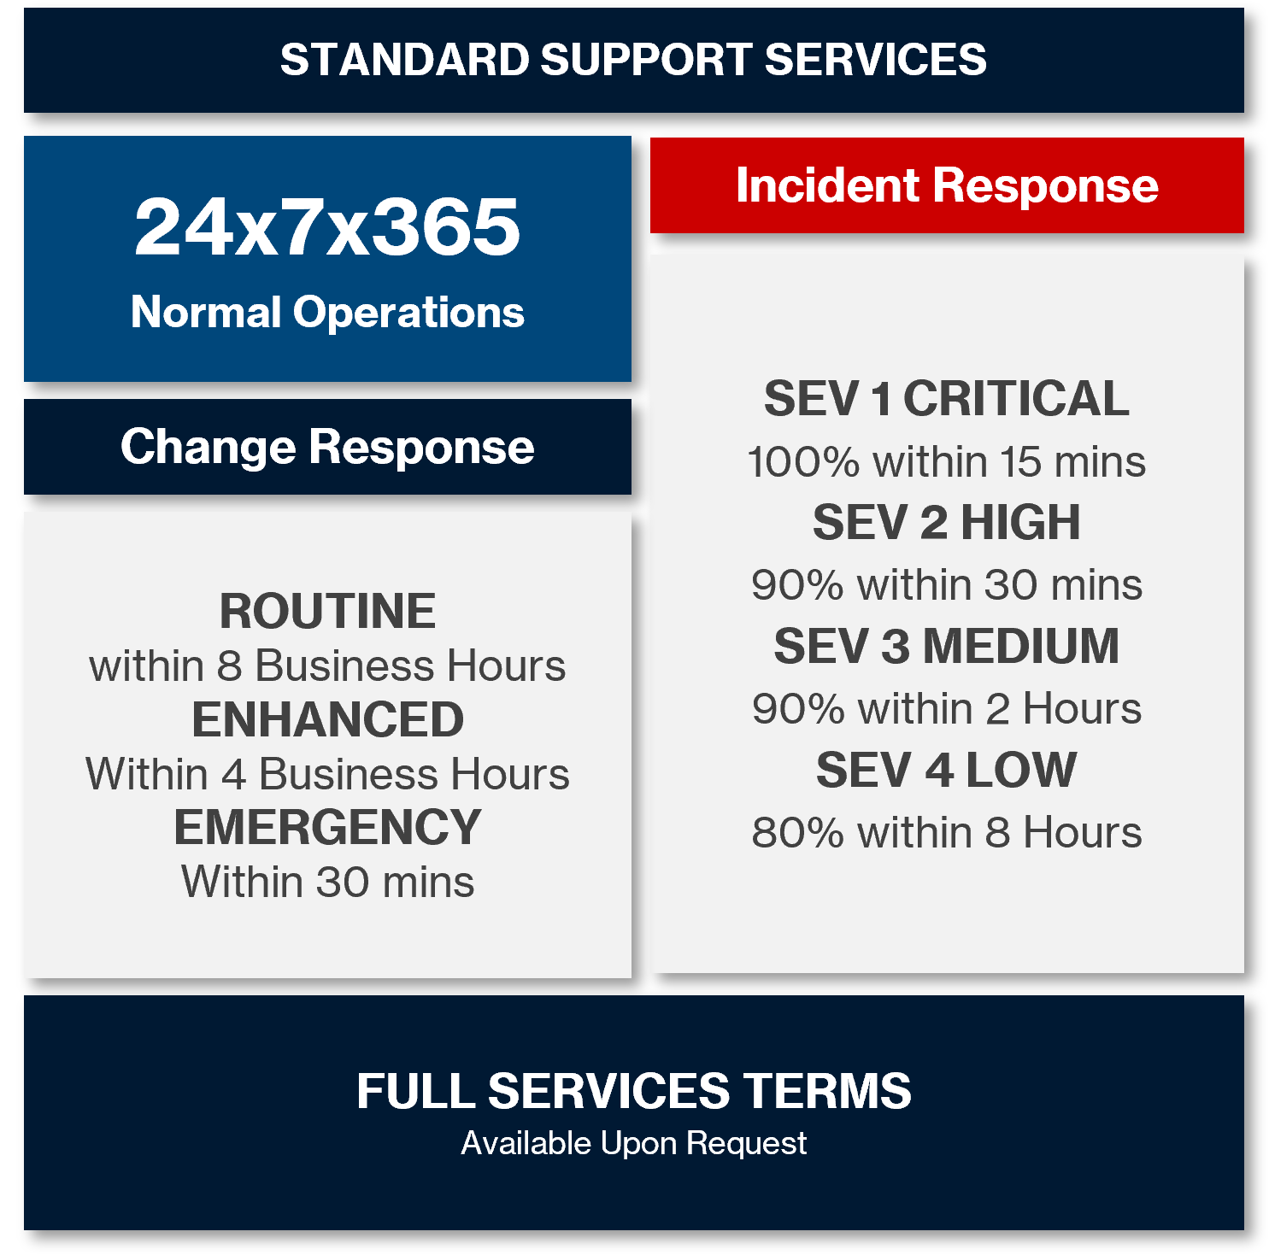
STaaS Subscription | Managed Your Way
99.99% to 99.9999%
Notes:
The STaaS Operational Service model offers a series of service levels and standard support levels.
<Click>
The primary SLAs are for Data Availability and Performance. Data Availability ranges from 4 nines for object to 6 nines for block and Performance Availability ranges from 4 nines for Object to 5 nines for block.
<Click>
The performance SLAs for each are listed here and range from less than 1 millisecond for the Ultra tier, to less than 7 milliseconds for the value tier, and both read and write performance levels for object.
<Click>
The STaaS Billing model is simple and transparent. For Object storage, billing is based on the maximum capacity usage during the billing period, whereas for block, it is based on used capacity averaged over the month based on 4 daily data captures.
<Click>
Standard support services are 24 by 7 by 365 during normal operations
<Click>
Incident response times reflect our standard service contract models from Severity 1 through Severity 4.
<Click>
Change response also follows are stand service contract models covering Routine, Enhanced and Emergency guidelines.
<Click>
Finally, all service terms are outlined and available upon request
<Click>

Slide 13





EverFlex STaaS | Engaging with Partners
Account access and business activation
Customer Success Manages Onboarding
Onboard
Partner Management approval for Partner Onboarding Approval
STaaS offering and business review
Review
Qualify
Partner and Business Opportunity
Contact STaaS Sales for assistance
Distribution
Engage with Hitachi Distribution PAM and Distributor
For EverFlex and STaaS, the Hitachi to Distribution terms take precedence
OR
Tier-1 Manage
Engage with local PAM team for Tier-1 Manage Partners
Agreement
Formalize new or updated partner legal agreement
Follow Legal Process
Notes:
Finally, lets cover the typical partner engagement process with STaaS.
First is to work with our partner, or prospective partner, to understand the business opportunity we would have together in this space.
Second is to align our joint partner management teams and approve moving forward.
Next is to engage with your Hitachi Distribution Partner Manager and Distribution Partner to ensure we onboard partner as seamlessly as possible. As stated previously, our Distributors are our primary route to market and have responsibilities that go beyond just transactional with STaaS. There are also operational requirements since our Distributor is responsible for deal management.
Once engaged, we review in detail the STaaS and EverFlex offering
Formally agree by signing the STaaS Service Summary agreement upfront
And then we formally onboard our partner with our Customer Success team
<Click>

Slide 14



STaaS Subscription | Key Differentiators
Partner Enterprise
g
Partner-centric. Built with partners in mind ensuring self-service control and subscriber management.
Enterprise class storage. 100% data availability guarantee leveraging Hitachi VSP enterprise-class storage.
g
Pricing and Governance
Predictable pay as you go. A variety of STaaS storage tiers and capacity levels supported by standardized rate cards upfront, SLAs and Service Credits.
Transparent billing. Simple billing models that are consistent across offerings & provide clear visibility into usage.
Coterminous capacity upgrades within the same tier.
Complete quote-to-cash lifecycle. Quote, order, reporting and billing management under one pane of glass with Hitachi Services Manager.
Deployment and Support
g
Fast time to market. Quote approval to delivery in weeks rather than months. Same day activation.
World class support. Trusted Hitachi global support being delivered to thousands of enterprise customers today.
Notes:
So what are the key differentiators for the Hitachi Vantara STaaS offering?
<Click>
First, STaaS was designed from the ground up making it Partner-centric.
It was Built with partners in mind ensuring self-service control and subscriber management.
Any cloud service is only as good as the technology from which it is developed and partners can rest comfortably knowing that STaaS leverages Hitachi Vantara Enterprise class storage. This means that partners get a 100% data availability guarantee leveraging Hitachi VSP enterprise-class storage.
<Click>
STaaS provide pricing and governance management including:
Predictable pay as you go pricing through A variety of STaaS storage tiers and capacity levels supported by standardized rate cards upfront so there are no surprises with pricing.
Transparent billing. Simple billing models that are consistent across offerings & provide clear visibility into usage.
Coterminous capacity upgrades within the same tier. No longer do you need to start a new contract when upgrading or growing the service.
And a Complete quote-to-cash lifecycle. STaaS provides Quote, order, reporting and billing management under one pane of glass with Hitachi Services Manager.
<Click>
And, deployment and support from Hitachi Vantara could not be simpler
STaaS supports:
Fast time to market. Quote approval to delivery is provides within weeks rather than months. It includes Same day service activation.
STaaS provides World class support from the Trusted Hitachi global support organization that delivers to thousands of enterprise customers today.
<Click>

Slide 15




STaaS/IaaS | Next Steps
STaaS Deep-dive
Agree to Partner
Plan, Develop, Strategy
Monetize
Request a follow-on deep-dive and demo
Determine engagement strategy and next steps
Verbal agreement to Partner
Partner with ‘as-a-Service’ agreement
STaaS Service Catalogue/Summary
Develop a go-forward plan
  (Hitachi Partner Team)
Onboarding and Enablement
  (Hitachi Partner Success)
Define partner engagement model
Define pricing model to Subscriber/Partners
Identify service RACI and owners
Define service messaging
Partner Enablement (Sales and Operations)
Target markets
Subscriber engagements
Marketing initiatives
Lead generation
Rules of engagement
Notes:
How do we engage together.
<Click>
To keep it as simple as possible, simply reach out to us for deep-dive review and planning
Request a presentation and demonstration of the service offering in detail
Assuming it aligns with your expectations and needs, lets determine what our engagement strategy and next steps plan would look like.
Also, agree verbally to partner with us
<Click>
Next, we then engage, plan and execute including formally partnering, developing our strategy and then monetizing to build pipeline and revenue.
<Click>

Slide 16

Thank You
Contact: STaaS Sales
Notes:
Thank you.

