Slide 1

Unstoppable: Enabling Hitachi + Cisco Customers & Partners
Achieve Your Hybrid Cloud Goals
With HC² (“Hitachi / Cisco - Hybrid Cloud Partnership”)
“Hitachi EverFlex with Cisco Powered Hybrid Cloud”

Slide 2



Trends Impacting the Data Center
AI
Sovereignty
Repatriation
Digital transformation global spending will reach
$3T+
Security
Sustainability
Performance
BY 2026

Slide 3



Business Outcome Focused
Faster time to value
Skills and resource gap
Challenges to solve
Guaranteed SLAs
Outcome-based solutions
Predictable and Flexible pricing

Slide 4




Hitachi Experience in As-a-Service
Delivering flexible Consumption solutions for
15+ years
Solution Scope
from
$2M to $50M+
BMW Group, Votable Bank, CBTS
and Deluxe are
examples of publicly referenceable case studies- for more visit HitachiVantara.com
More information
is available in the Reference &
Resource Center

Slide 5















As-a-Service Portfolio
Managed & Flexible Consumption Options
EVERFLEX CONTROL
Observability
Self-Service Portal
Alert Management
AIOps
CISCO POWERED SOLUTIONS
HV POWERED SOLUTIONS
ADD-ON SERVICES
Multi-Cloud
Block Storage
Data Protection
FinOps
Object Storage
File Storage
Hybrid Cloud VMs
Security/Ransomware
FUTURE SERVICE OPTIONS
Hybrid Cloud Containers
DevSecOps
Data Models
Generative AI

Slide 6











The Most Resilient and Scalable Hybrid Cloud Infrastructure
HC²
MORE WORKLOADS, LESS INFRASTRUCTURE, BETTER TCO!
Unified platform
for applications
and data
Increase Agility, Velocity, Observability, & Portability
Automated infrastructure operations
True Consumption
MAXIMIZE IT AGILITY WITH FLEXIBLE CONSUMPTION MODELS
Improved Operational Efficiency
Significant TCO reduction
Cloud attributes within the data center
Infrastructure
as-a-service
Become a Cloud Broker
SLA-backed
assurance

Slide 7






Unlock Unmatched IT Flexibility and Efficiency with Hitachi EverFlex Levels of Service
Product
Consumption
Foundation
Managed
Business Value and TCO Savings
Purchase or Lease
Consumption Based Pricing
Client or
Partner Managed
Hitachi Managed
Consumption or Subscription-based billing with Service Level Agreement
EverFlex Control: Advanced Observability, Monitoring, Reporting, AIOps, services-based consumption
24/7 Business Aligned Service Operations
Professional Services & Technology

Slide 8
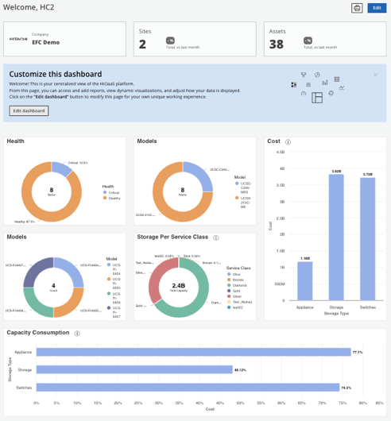










Hitachi EverFlex Hybrid Cloud Advantage
EverFlex Control
Centralized Control & Cloud Experience
Heterogeneous AIOps Tools
API-centric Control and Data Plane
Alert Reduction & Correlation
Elastic Pay Per Use
Billed on true consumption
Flex up and Down
Predictable and Managed
Self-Service
Move, Add, Change & Delete
Consolidated reporting
End to End Automation & Orchestration
Business process integrated
Workflow integrated configurations
Guardrails on spend and configurations
ITSM/ITOM Integrated
Secure
Persona based ACL
Not publicly accessible
Resilience and highly available
Agile & Reliable
Quickly configure based on requirements
Stable and ready for use
Predefined Enterprise Architecture
Portability
Ability to move workloads between private & public clouds
Workload modeling, placement and optimization
Continuous Improvement
Constantly enhanced and expanded services
IT Infrastructure Innovation
Low-Risk Services Portfolio
Service Catalog & Application blueprints
Ecosystem of Integrated ISV Architectures
and Solutions
SLA Backed
Worry free experience
Contractual platform expectations

Slide 9




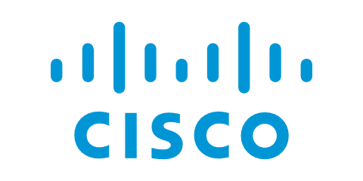



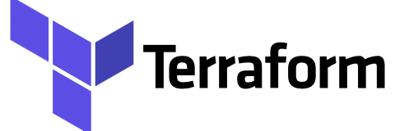




Hitachi EverFlex with Cisco Powered Hybrid Cloud featuring EverFlex Control
Heterogenous Infrastructure
Automation
Software
Hardware
Unified Portal
Heterogeneous
Self-Service
Provisioning
Business Processes
Observability
Alert Reduction
Alert Correlation
Self-Healing
FinOps
Application Portability
Cisco Intersight
Cisco Nexus Dashboard
Hitachi EverFlex Control
Hitachi Ops Center
Heterogeneous Management Tools
Cisco UCS
X-Series
C-Series
CI & HCI
Cisco Networking
Nexus
MDS
Fabric Interconnects
Hitachi Storage
Block
File
Object
Heterogeneous Infra
API Integrations
Technology Agnostic

Slide 10













HC² – Targeted Use Cases
Financial
Operational
Technical
TCO Reduction
Improved Observability
VMware Reduction
CapEx vs OpEx
Automation & Self Healing
Public Cloud Repatriation
Cost Management - FinOps
Risk Reduction
Hybrid Cloud Adoption
Sustainability Improvement
Operational Skills Gap
Infrastructure Modernization

Slide 11






TCO Improvement Summary
~43%
Reduction of servers
~32%
Reduction Cost per
GB data
Significant
TCO
Savings
~30%
Cost Avoidance in Software licensing
~40%
Potential Reduction in Storage Capacity
~$36%
Reduction in
Operational Labor
~50%
Fewer network
switches required

Slide 12
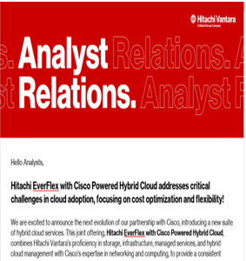








Positive Analyst Feedback
“Pairing two major industry players, the new Hitachi EverFlex with Cisco Hybrid Powered Cloud has the potential to shake up the growing market for dedicated infrastructure offered as-a-service, and with operationally friendly consumption options” - IDC
“Everyone charged into the cloud at the height of the pandemic because it seemed the only way to keep the lights on. Now, there are cloud management and cost headaches everywhere you look. The combination of Hitachi and Cisco is beneficial to customers. Cisco certainly brings infrastructure to the table, and Hitachi has the managed services chops that will be critical for companies looking to expand or simply maintain their cloud presence.” - ZK Research
IDC: Hitachi Vantara Expands Partnership with Cisco to Offer New Services for Converged Infrastructure in Hybrid Clouds
Constellation Research Inc: Hitachi Vantara, Cisco launch hybrid cloud suite.

Slide 13
Partner
Enablement

Slide 14






What’s In It For You the Partner?
Simple & Market-Proven Consumption Model (“EverFlex”)
Easy to add partner-led services
Partner maintains account relationship & control
End-user pricing set by Partner
$$$$ - Recurring Revenue - the gift that keeps giving
Operational and Financial Risk Mitigation

Slide 15



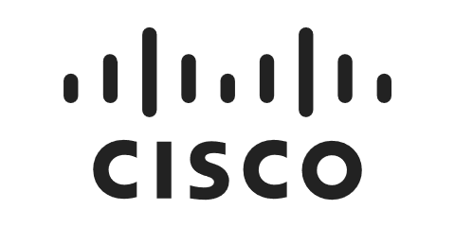


Go to Market / Sales Enablement
PARTNER FOCUSED
HC² Sales PODS
HITACHI VANTARA HC² POD
Services Sales/Proposal
Solutioning/Technical
Financial/Pricing
Partner Channel
Partners
CISCO
Assist and validate solution architecture
Ensure alignment to Cisco best practices
Collaborate with Partner and HV Teams
Hitachi Field AM's
CISCO
Data Center Sales
HITACHI VANTARA
Finalize service classes and capabilities
Document operational savings
Calculate operational labor reduction due to automation

Slide 16

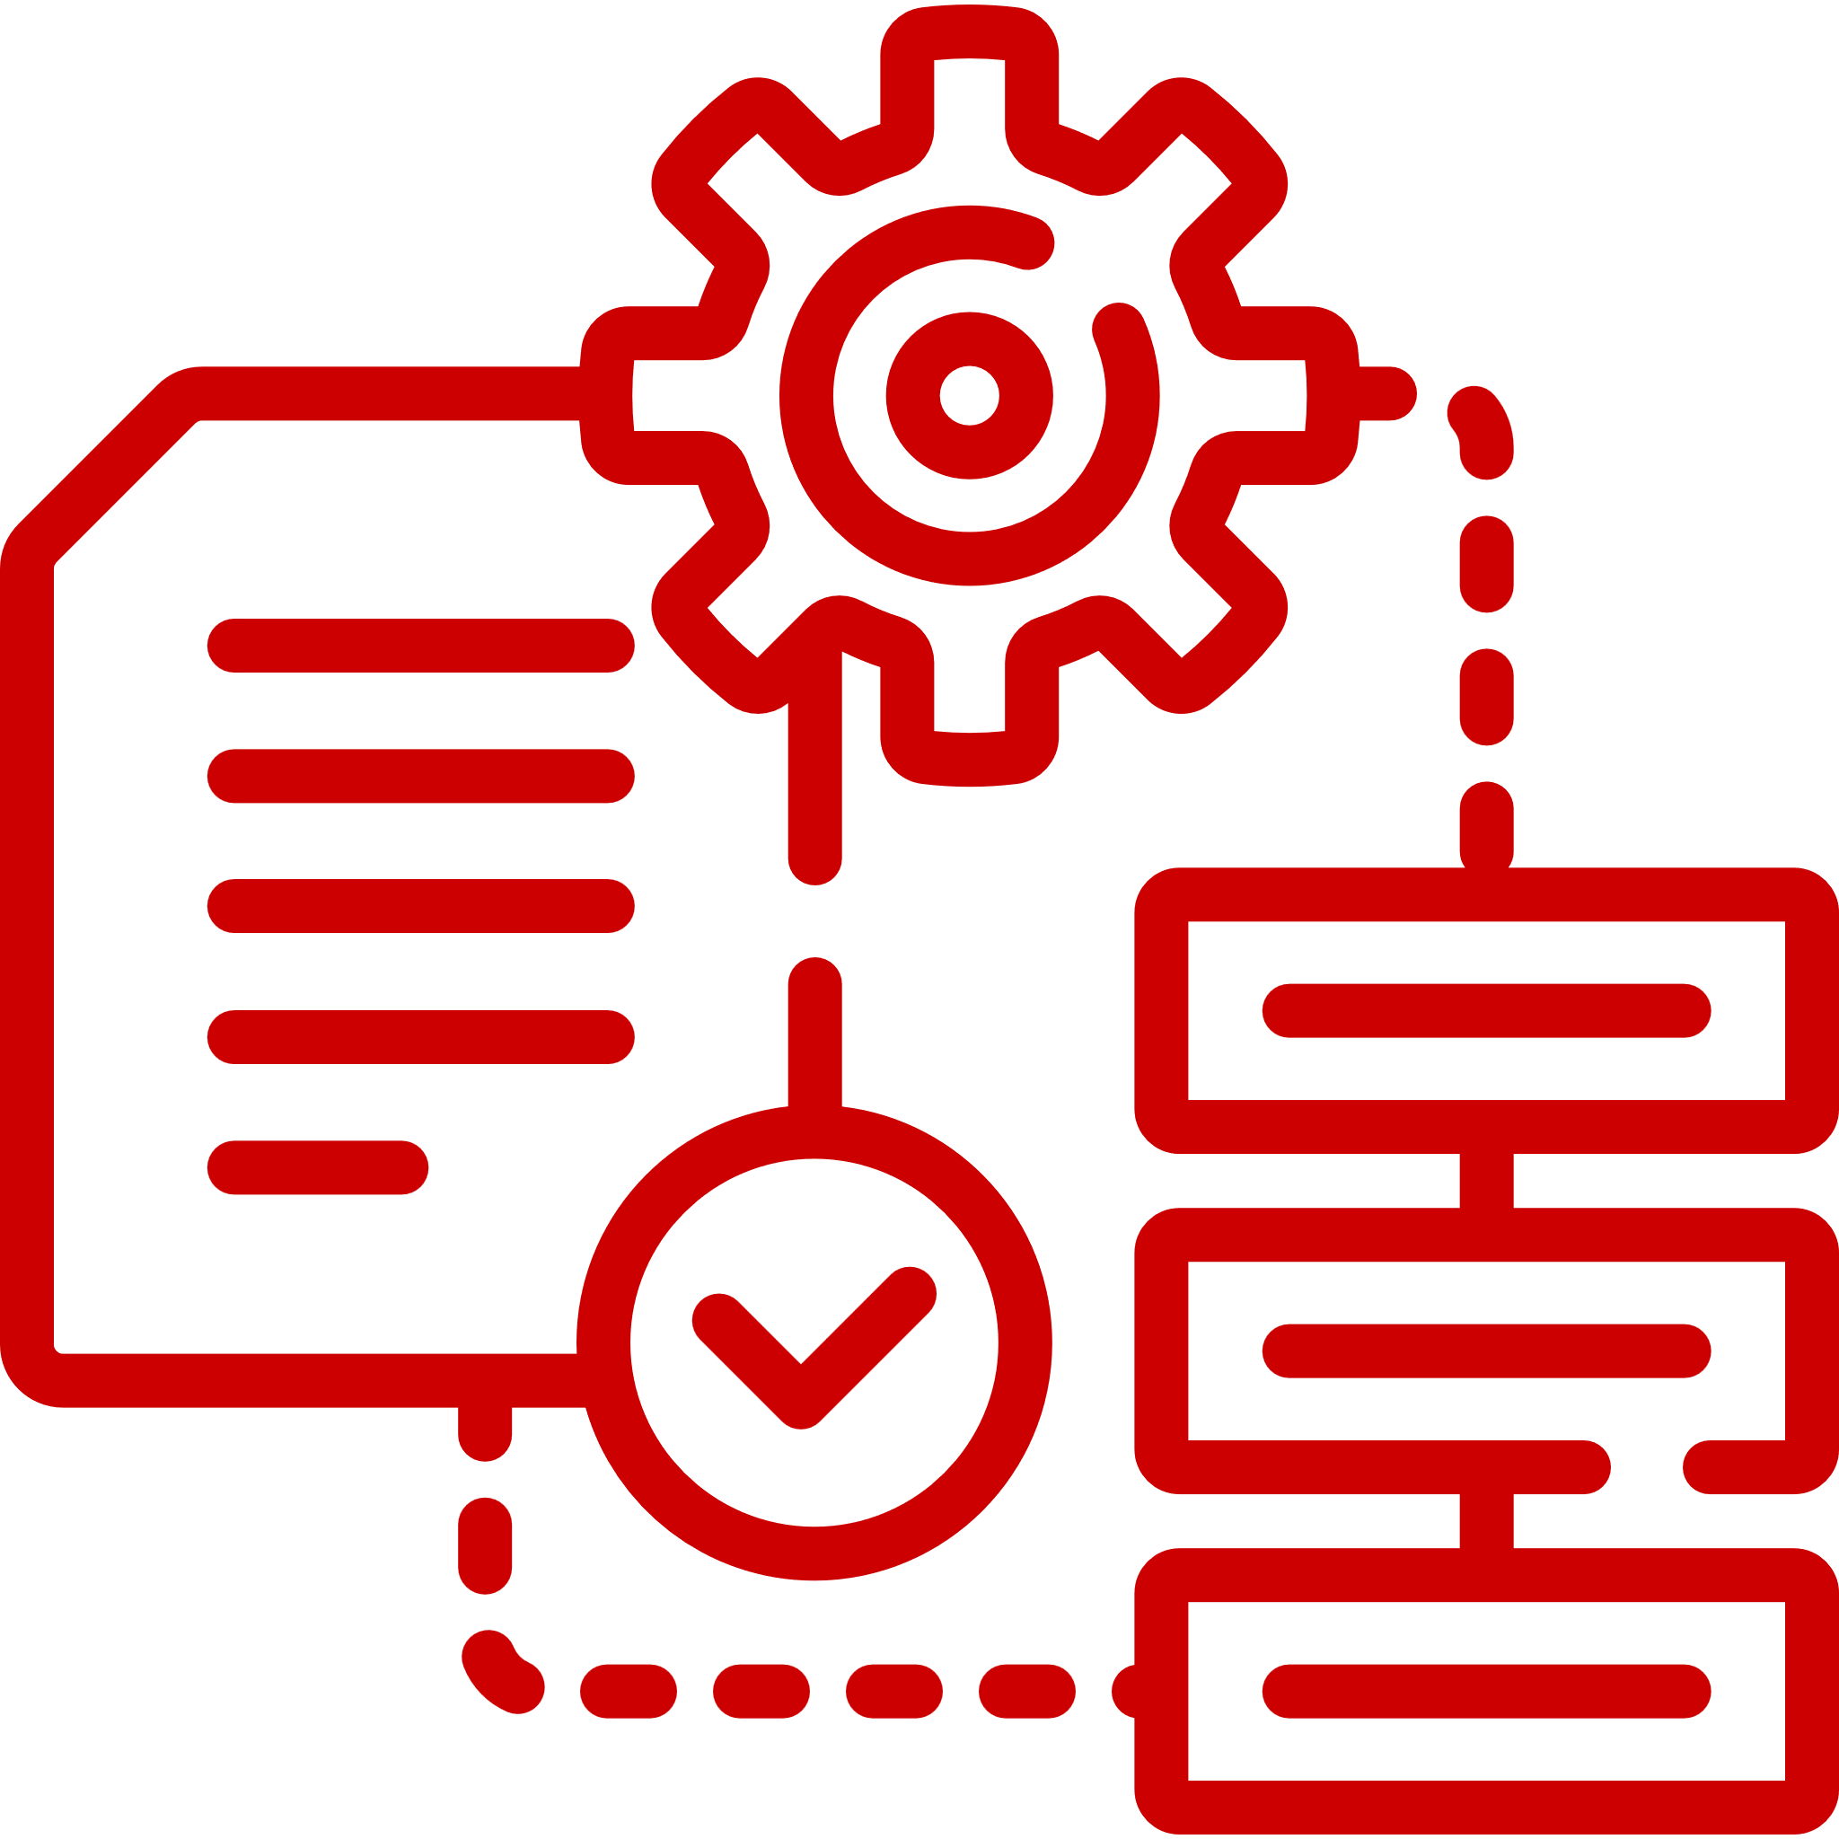



Ease of Doing Business
Partner Enabled and Channel Ready
Partner process simplified to offer customers
integrated services and solutions
CISCO
Hitachi Vantara
Distributor
Hitachi/Cisco
Partners
End Customer
Hardware & Software Fulfillment
Partner Support
Direct Sales Engagement
Partner support
Cloud-like consumption solutioning
Deploy & Delivery
Direct Sales Engagement
Partner relationships
Consolidated billing and credit lines
Contract process
Manage customer relationships
Engage and coordinate with HV and Cisco
Augment offering with own services
Subscribe to EverFlex contracted to partner
Support direct from Hitachi or via partner helpdesk
Pre-Sales Engagement

Slide 17


Partner Value GoTo Market Paths
EverFlex – Hitachi & Cisco
GPL – Hitachi & Cisco
Task | Owner
Engages with Hitachi/Cisco to Scope Customer Environment | Partner
Quote Creation (Cisco Hardware/Software) | Partner/Cisco
Hitachi Deal Registration | Partner
Deal Registration Confirmation | Hitachi
“Quick Quote” Approve | Cisco
Deal Qualification | Hitachi
TCO Analysis | Hitachi
Quote Creation (Hitachi Hardware & Software) | Hitachi
“To Partner” Pricing & Supporting Documents | Hitachi
“To Customer” Pricing & Supporting Documents plus additional value-added services | Partner
Task | Owner
Engages with Hitachi/Cisco to Scope Customer Environment | Partner
Outline Partner delivered services | Partner
Provide Customer outline and desired outcomes to Hitachi and Cisco | Partner
Provide desired architecture to meet Customer needs | Partner/Cisco/Hitachi
Deal Qualification | Hitachi
TCO Analysis | Hitachi
Quote Creations | Partner/Cisco/Hitachi
Provide PID Details for ordering | Hitachi
Configure PID in Cisco GPL for customer order | Partner
Deliver pricing and supporting documents to Customer | Partner

Slide 18
HC²
(Hitachi EverFlex with Cisco Powered Hybrid Cloud)
Key Information

Slide 19







Prospecting and Hot Customer Topics
SW licensing costs have increased
Desire to reduce time to value with automation and self-service
Total Cost of Ownership is too high
Desire to adopt flexible consumption model (cloud-like)
GreenLake, Apex, KeyStone consumers
Too Many tools, Observability challenges
Align workload to proper infrastructure to ensure reliability and cost control
What can containers do for me?

Slide 20

Hitachi EverFlex Competitive Advantages
Featuring | EverFlex from Hitachi | HP GreenLake | Dell APEX
Predictable Pay per use Pricing
Headless Automation Platform Bi-Directional API Extensibility
Unified Self-service Portal
Heterogenous Platform Integration Including IT and Business Processes
Full Lifecycle Management Including 3rd party decommissioning
Hybrid Cloud FinOps Across On-Prem and Cloud environments
Custom Platform Integrations

Slide 21






Solution Recap
OPTIMIZED SOLUTION
Hybrid platform for virtualized and
container applications
SELF SERVICE
Integrated automation, blueprinting and web portal
for end users
CONTROLLED RISK
Address shadow IT with enterprise- backed SLAs
PAY AS YOU GO
Small entry point, no upfront cost and transparent pricing
PREDICTABLE PRICING
No hidden costs
And standard consumption units

Slide 22
Thank You

Slide 23



New Hitachi EverFlex | Infrastructure as a Service Portfolio
EverFlex is a portfolio of as-a-service and consumption-based offers
for workload transformation and hybrid cloud operations
EverFlex Control
EverFlex Infrastructure Solutions
Professional Services
Vertical Blueprints
Orchestration Workflows
Automations Workflows
Project Resources and Mgt
VMware to K8s
Advanced Observability
SAP
Oracle
AI/ML Workloads
Hybrid Cloud
Private Cloud
RAG/Training
Self Service Portal
Heterogeneous Observability & Orchestration
Intelligent Alert Management
Automation and Self-Healing
AIOps
Provisioning
Quote-to-Billing Lifecycle
EverFlex Service Catalog
IaaS with Cisco
Storage (STaaS) Block
Storage (STaaS) File
Storage (STaaS) Object
FinOps
Data Protection (DPaaS)
SAN Networking (SNaaS)
Dev Sec Ops
Bare Metal (BMaaS)
Containers (CaaS)
Virtual Machine (VMaaS)
Converged Infrastructure (CIaaS)

